Slide 1
Virtual Private Network
Dr. Muazzam A. Khan

Slide 2
Virtual Private Networks
Introduction
What security problems do VPNs solve ?
What security problems are not solved by VPNs ?
VPN Principles of operation: tunneling, encapsulation, encryption and authentication
VPN Technologies: Microsoft PPTP, L2TP and IPsec

Slide 3
Virtual Private Network is a type of private network that uses public telecommunication, such as the Internet, instead of leased lines to communicate.
VPNs enabled more flexible use of larger networks by removing network geography constraints from shared-insider LAN/Intranet associations and services.
Virtual Private Networks

Slide 4
What problems do VPNs solve ?
Avoiding costs of fixed lines.
Extending security context of LAN across sites, regardless of geography, including to mobile users.
Authentication: knowing who your users are.
Encryption: preventing monitoring of use of insecure client server applications at the network level.

Slide 5
What security problems do VPNs not solve ?
Traffic analysis: monitoring of packet sizes, network usage times, endpoints of conversation etc.
VPNs can be used with firewalls, by encapsulating traffic prohibited by organisation policy within a firewalled perimeter which the firewall can't inspect or control.

Slide 6
Tunneling
Typically a VPN consists of a set of point to point connections tunnelled over the Internet.
The routers carrying this traffic over the Internet see each P2P connection externally as a sequence of packets routed between endpoints.

Slide 7


VPN Architecture
ISP
VPN
Device
Access
Server
leased circuits
Office
Telephone
Line
VPN
Device
Employee’s
Home
Internet
Backbone
VPN Tunnel
VPN Tunnel
Office
VPN
Device
VPN is transparent to the users, ISP, and the Internet as a whole;
It appears to be simply a stream of packets moving across the Internet
Backbone

Slide 8
Encapsulation
In order to achieve tunnelling,
The packets including payloads, to and from addresses, port numbers and other standard protocol packet headers are encapsulated as the payload of packets as seen by the external routers carrying the connection.

Slide 9
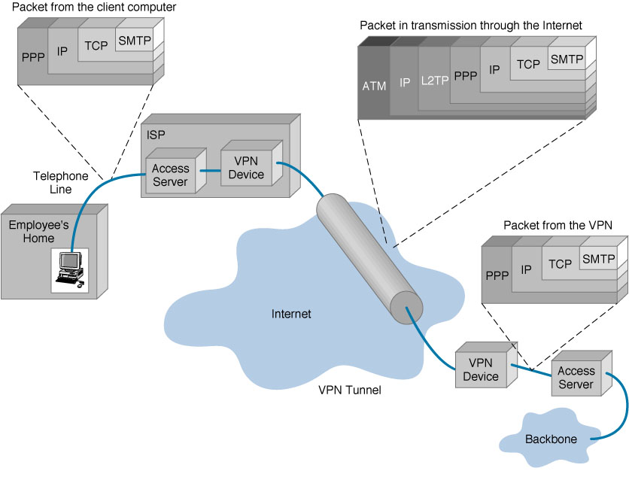

Slide 10
Authentication
A digital signing scheme is typically used to enable verification of the VPN principals. Note that both the client and the server need to authenticate each other.
Message authentication codes, hashes or checksums are typically used to authenticate message contents.

Slide 11
Encryption
To protect the privacy of the connection from external snooping, the payload of the packets visible externally will be encrypted.
To enable routing over conventional networks, the packet headers of the 2nd encapsulating packets are not encrypted, but the packet headers of the 1st encapsulated packets are encrypted along with their contents.

Slide 12
VPN Topology: Types of VPNs
Remote access VPN
Site-to-Site VPN

Slide 13
Types of VPNs
Remote Access VPN
  Provides access to internal corporate network over the Internet.
  Reduces long distance technical support costs.
Corporate
Site
Internet

Slide 14
Types of VPNs
Corporate
Site
Remote Access VPN
Site-to-Site VPN
  Connects multiple offices over Internet
  Reduces dependencies on frame relay and leased lines
Internet
Branch
Office

Slide 15
Types of VPNs
Remote Access VPN
Site-to-Site VPN
  Extranet VPN
    Provides business partners access to critical information (Fin, sales tools, etc)
    Reduces transaction and operational costs
Corporate
Site
Internet
Partner #2
Partner #1

Slide 16
Types of VPNs
Remote Access VPN
Site-to-Site VPN
  Extranet VPN
  Intranet VPN:
Links corporate headquarters, remote offices, and branch offices over a shared infrastructure using dedicated connections.
Database Server
LAN clients
Internet
LAN clients with sensitive data

Slide 17
VPN Topology: How it works
Operates at layer 2 or 3 of OSI model
  Layer 2 frame – Ethernet
  Layer 3 packet – IP

Slide 18
VPN Components: Protocols
IP Security (IPSec)
  Transport mode
  Tunnel mode
Point-to-Point Tunneling Protocol (PPTP)
  Uses PPP (Point-to-Point Protocol)

Slide 19
VPN Components: Protocols
Layer 2 Tunneling Protocol (L2TP)
  Exists at the data link layer of OSI
  Composed from PPTP and L2F (Layer 2 Forwarding)
  Compulsory tunneling method

Slide 20
Point-to-Point Tunneling Protocol (PPTP)
Layer 2 remote access VPN distributed with Windows product family
  Based on Point-to-Point Protocol (PPP)
Uses proprietary authentication and encryption
Limited user management and scalability
Corporate Network
Remote PPTP Client
PPTP RAS Server
Internet
ISP Remote Access
Switch

Slide 21
PPP
Point-to-Point Protocol (PPP)
  PPP was created for dialing into a local RAS (Remote Access server)
  But the site’s RAS may be far away
  Long-distance calls are expensive
RAS
Long-Distance Call

Slide 22
PPTP
Point-to-Point Tunneling Protocol (PPTP)
  We would like PPP to work over the Internet to avoid long-distance telephone charges
  But PPP is only a data link layer protocol
  It is only good for transmission within a subnet (single network)
RAS

Slide 23
PPTP
The Point-to-Point Tunneling Protocol (PPTP) makes this possible
  Created by Microsoft
  Widely used
Access
Concentrator
RAS

Slide 24
PPTP
PPTP Operation
  User dials into local PPTP access concentrator host
  User sends the access concentrator a PPP frame within an IP packet
Access
Concentrator
RAS
Packet

Slide 25
PPTP
PPTP Operation
  Access concentrator places incoming IP packet within another IP packet
  Sends packet to the distant RAS
Access
Concentrator
RAS
Encapsulated Packet

Slide 26
PPTP
PPTP Operation
  Distant RAS removes the original packet
  Deals with the PPP frame within the packet
RAS

Slide 27
PPTP
PPTP Encapsulation
  Access concentrator receives the original IP packet, which has the IP address of the access concentrator
  Adds an enhanced general routing encapsulation (GRE) header for security
  Adds a new IP header with the IP address of the RAS
Original IP Packet
Enhanced
GRE Header
New
IP Header
RAS
Access
Concentrator
Tunnel

Slide 28

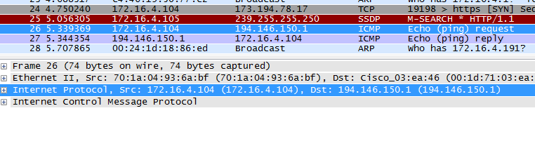

Slide 29
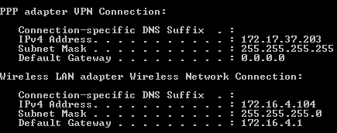
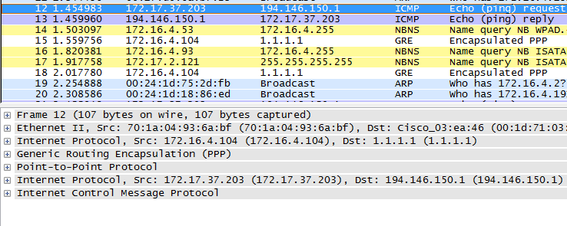

Slide 30
IPSec
IPSec is an Internet Engineering Task Force (IETF) standard suite of protocols that provides data
  authentication
  confidentiality
  key management
Applicable to use over LANs, across public & private WANs, & for the Internet
Notes:
IP-level security encompasses three functional areas: authentication, confidentiality, and key management. The authentication mechanism assures that a received packet was transmitted by the party identified as the source in the packet header, and that the packet has not been altered in transit. The confidentiality facility enables communicating nodes to encrypt messages to prevent eavesdropping by third parties. The key management facility is concerned with the secure exchange of keys. IPSec provides the capability to secure communications across a LAN, across private and public WANs, and across the Internet.

Slide 31
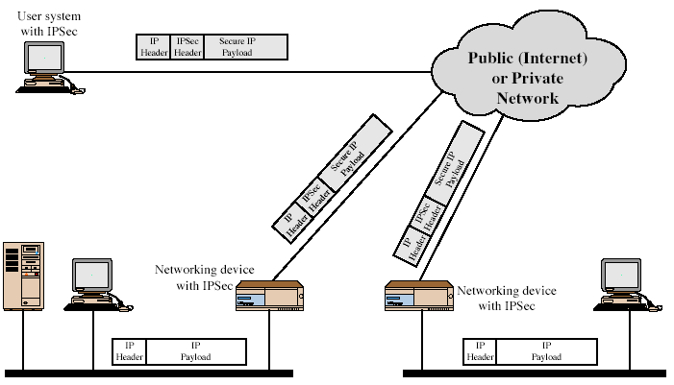
IPSec Uses
Transparency
Notes:
Stallings Figure 16.1 illustrates a typical IP Security scenario. An organization maintains LANs at dispersed locations. Nonsecure IP traffic is conducted on each LAN. For traffic offsite, through some sort of private or public WAN, IPSec protocols are used. These protocols operate in networking devices, such as a router or firewall, that connect each LAN to the outside world. The IPSec networking device will typically encrypt and compress all traffic going into the WAN, and decrypt and decompress traffic coming from the WAN; these operations are transparent to workstations and servers on the LAN. Secure transmission is also possible with individual users who dial into the WAN. Such user workstations must implement the IPSec protocols to provide security.
Security Associations
A one-way relationship between sender & receiver that affords security for traffic flow
Can be between
A pair of hosts
A host and a security gateway
A pair of security gateways

Slide 32
Benefits of IPSec
Its below transport layer, hence transparent to applications
Can be transparent to end users
Can provide security for individual users
Notes:
[MARK97] lists the benefits shown for IPSec. It also plays a vital role in the routing architecture required for internetworking.

Slide 33
Architecture & Concepts
Tunnel vs. Transport mode
Security association (SA)
  Security parameter index (SPI)
  Security policy database (SPD)
  SA database (SAD)
Authentication header (AH) Protocol
Encapsulating security payload (ESP) Protocol

Slide 34
Transport Mode vs. Tunnel Mode
Transport mode: host -> host
Tunnel mode: gateway->gateway
Encrypted Tunnel
Gateway 1
Gateway 2
Encrypted
Unencrypted
A
Unencrypted
B
New IP Header
AH or ESP Header
Orig IP Header
TCP
Data
Notes:
The difference between end-to-end (transport) mode and end-to-intermediate (tunnel) mode.
Transport mode provides protection primarily for upper-layer protocol payloads, by inserting the AH after the original IP header and before the IP payload. Typically, transport mode is used for end-to-end communication between two hosts.
Tunnel mode provides protection to the entire IP, after the AH or ESP fields are added to the IP packet, the entire packet plus security fields is treated as the payload of new “outer”IP packet with a new outer IP header. Tunnel mode is used when one or both ends of an SA are a security gateway, such as a firewall or router that implements IPSec.

Slide 35
Transport Mode
IP
header
IP
options
IPSec
header
Higher
layer protocol
ESP
Real IP
destination
AH
ESP protects higher layer payload only
AH can protect IP headers as well as higher layer payload

Slide 36
Tunnel Mode
Outer IP
header
IPSec
header
Inner IP
header
Higher
layer protocol
Destination
IPSec
entity
ESP
Real IP destination
AH
ESP applies only to the tunneled packet
AH can be applied to portions of the outer header

